Slide 1
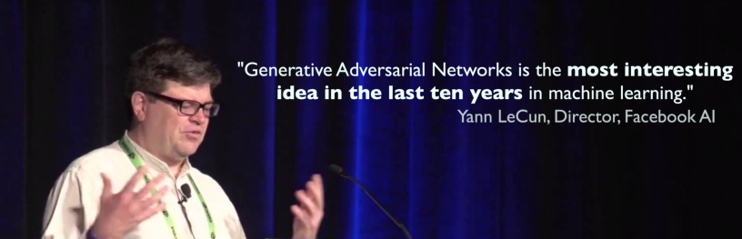
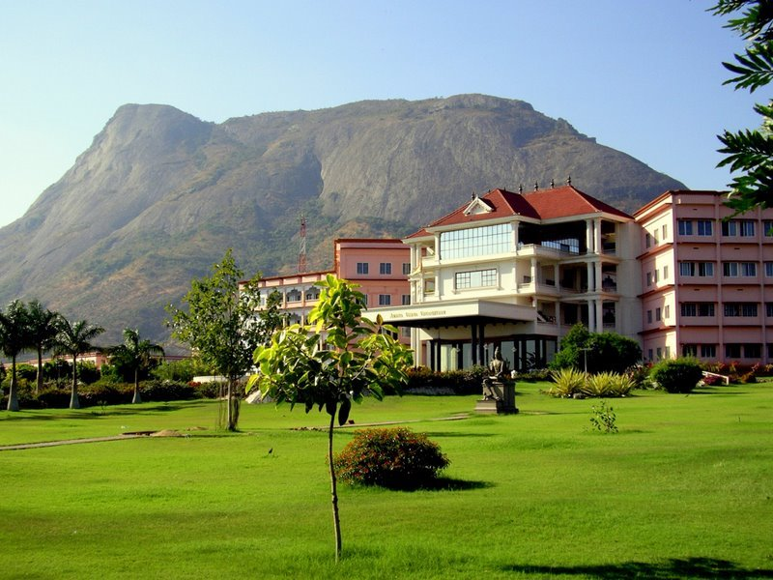

GENERATIVE ADVERSARIAL NETWORKS (GAN)
Dr. V. SOWMYA
Assistant Professor, Center for Computational Engineering and Networking (CEN), Amrita School of Engineering, Coimbatore.
v_sowmya@cb.amrita.edu

Slide 2
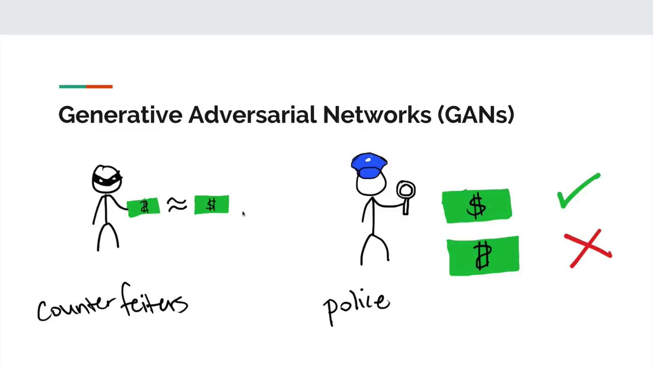
ANALOGY OF GAN

Slide 3
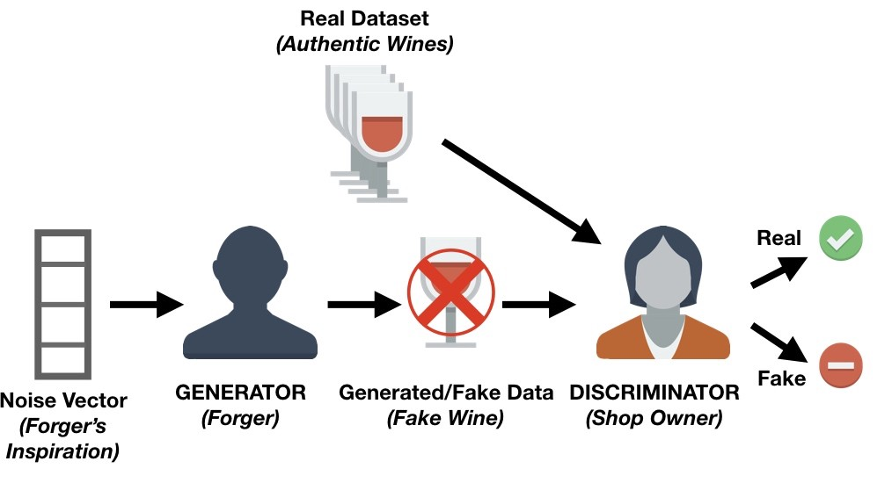
ANALOGY OF GAN

Slide 4
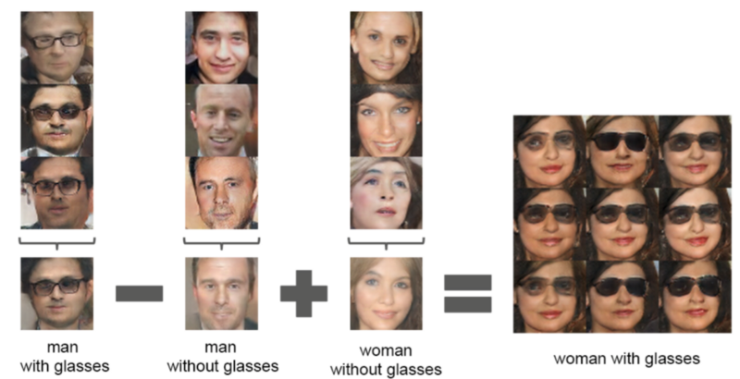
POWER OF GAN

Slide 5
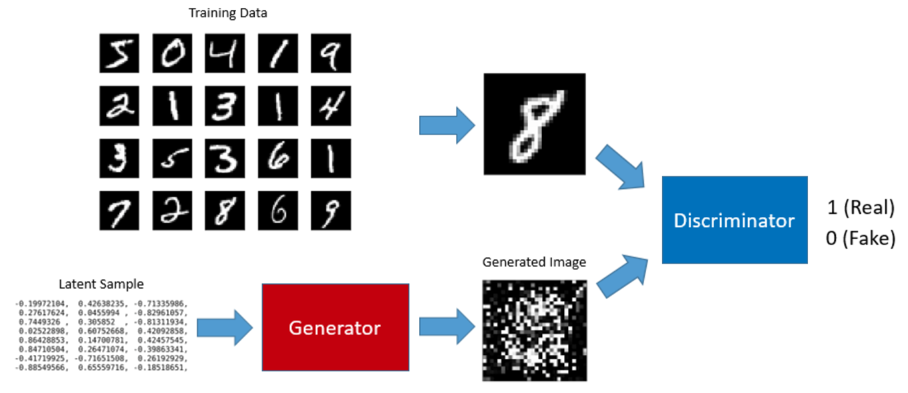
COMPONENTS OF GAN

Slide 6
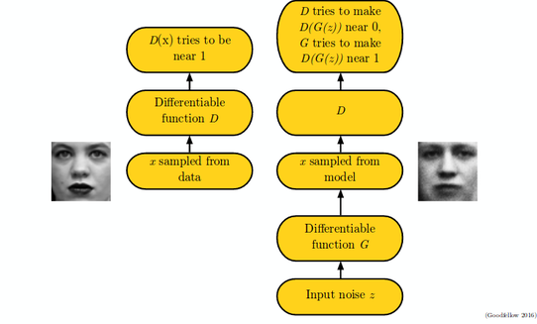
OBJECTIVES OF THE COMPONENTS OF GAN

Slide 7
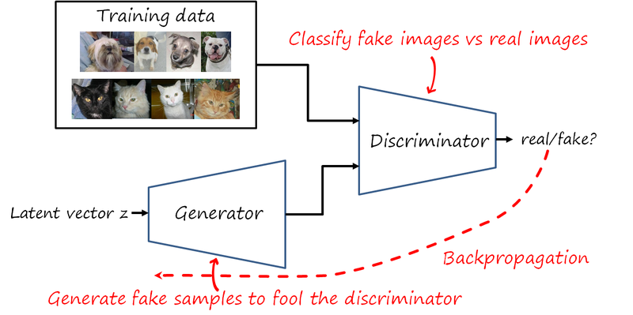
BACKPROPAGATION IN GAN

Slide 8
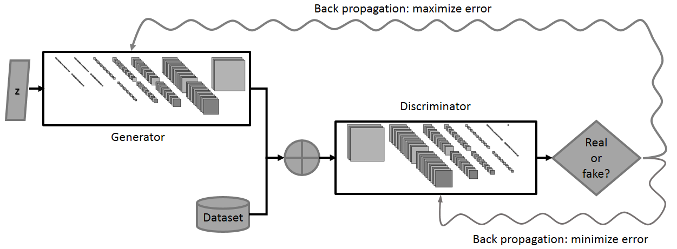
MIN-MAX GAME (Adversarial Learning) IN GAN

Slide 9
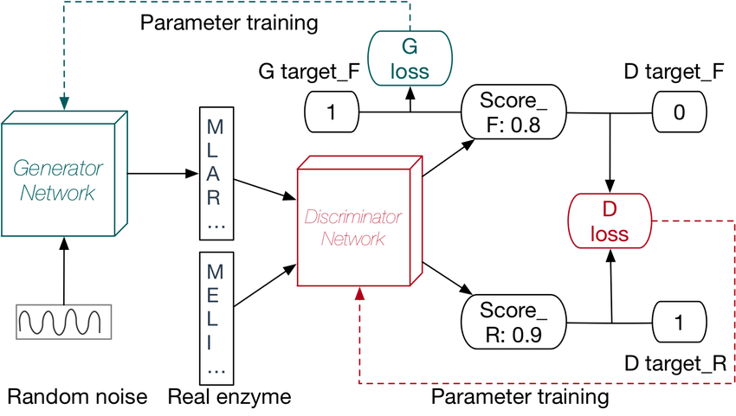
UNDERSTANDING GAN’s LOSS COMPUTATION

Slide 10
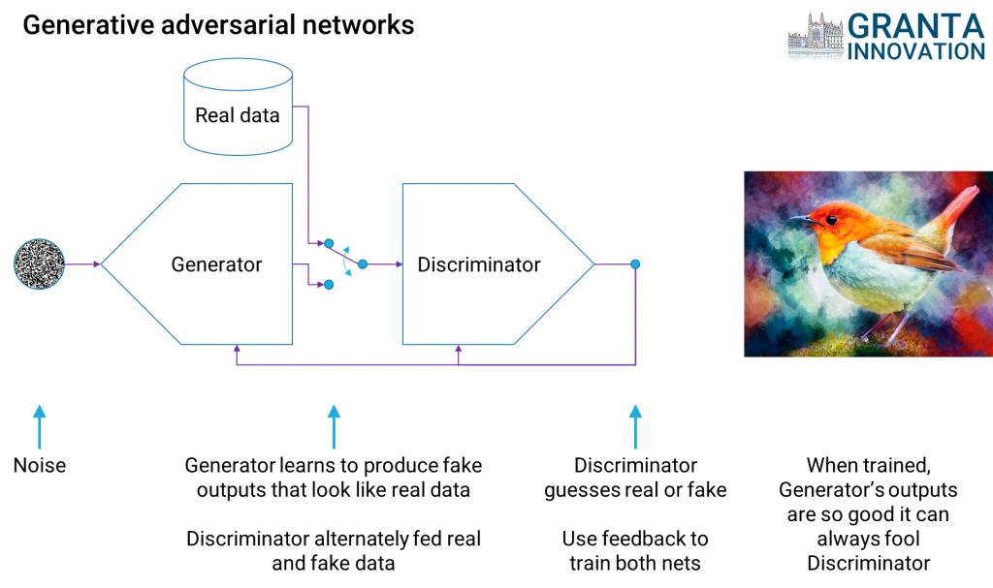
GAN IN FORMAL

Slide 11
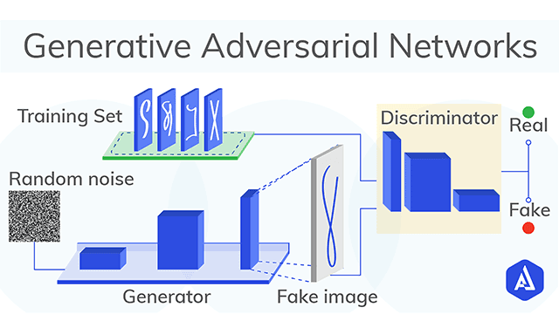
GAN IN FORMAL

Slide 12
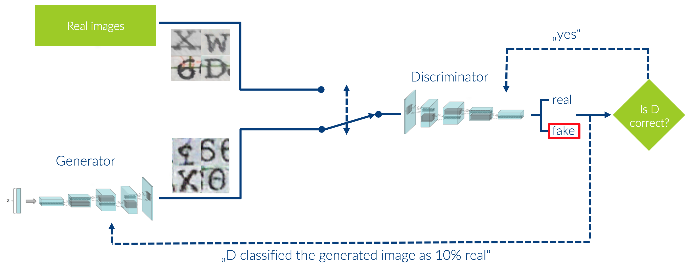
GAN IN FORMAL

Slide 13
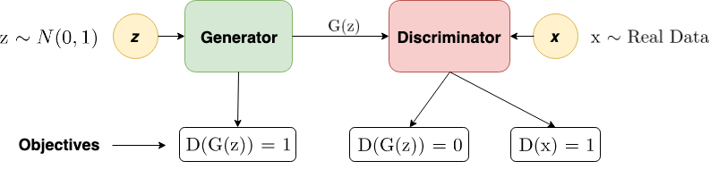
GAN IN FORMAL

Slide 14
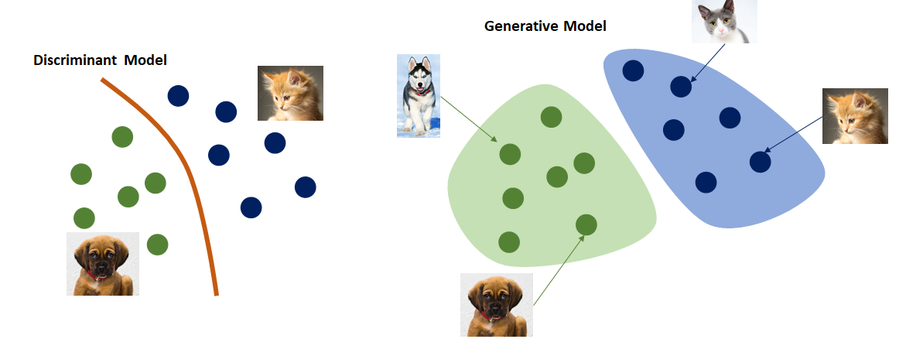
GENERATIVE Vs DISCRIMINATIVE

Slide 15
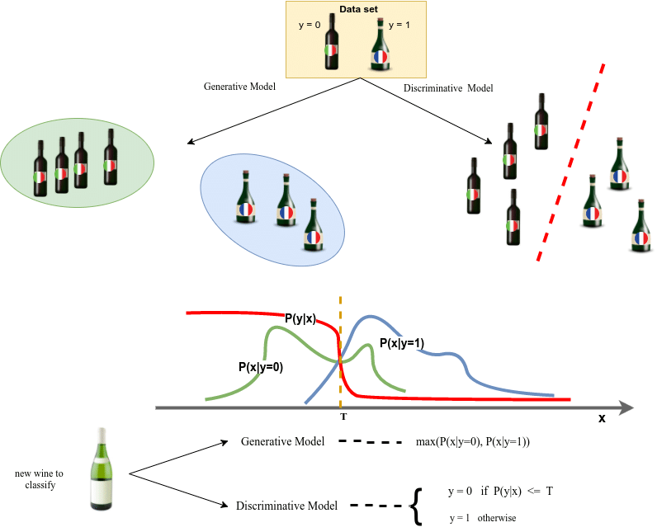
GENERATIVE Vs DISCRIMINATIVE

Slide 16
GENERATIVE Vs DISCRIMINATIVE
DISCRIMINATIVE – p(y/x) – learns the conditional probability distribution.
GENERATIVE – P(x,y) = P(y/x) P(x) – learns the joint probability distribution

Slide 17
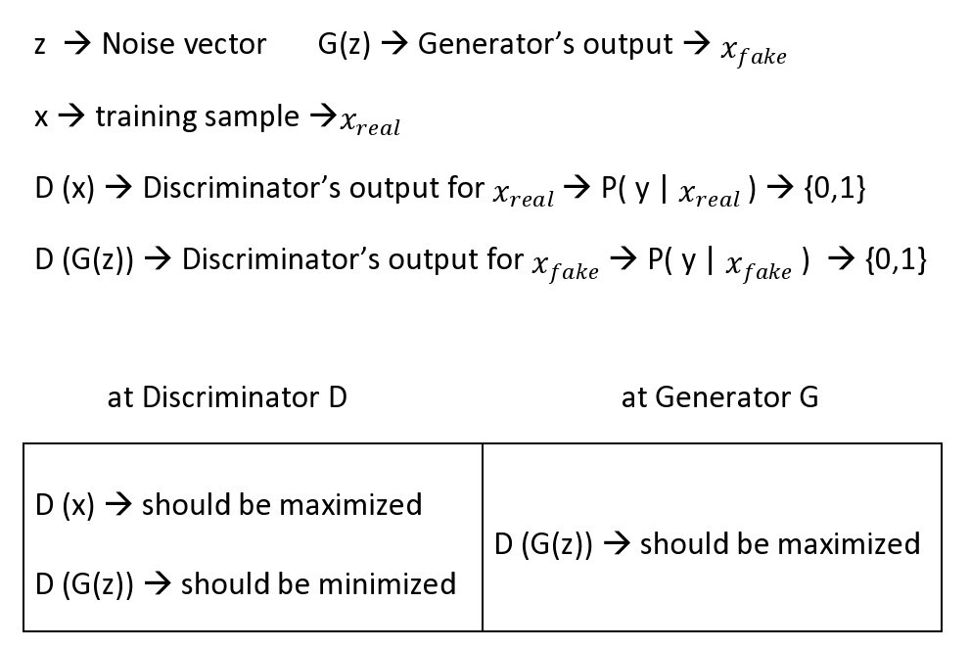
MATH BEHIND GAN

Slide 18
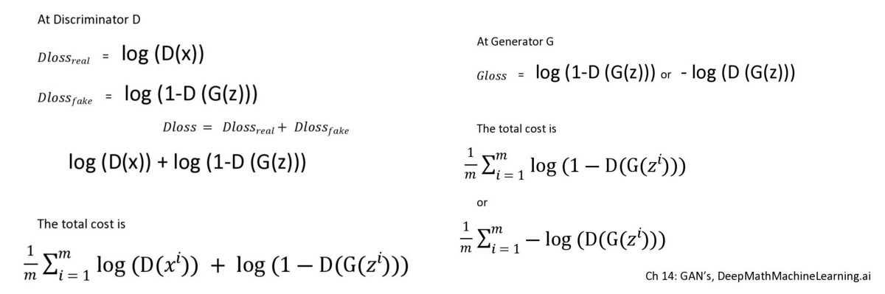
MATH BEHIND GAN

Slide 19
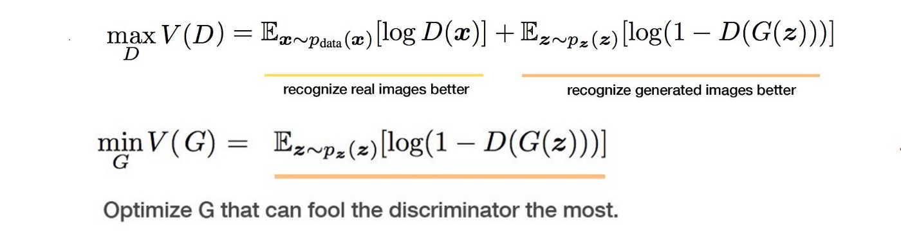
MATH BEHIND GAN

Slide 20
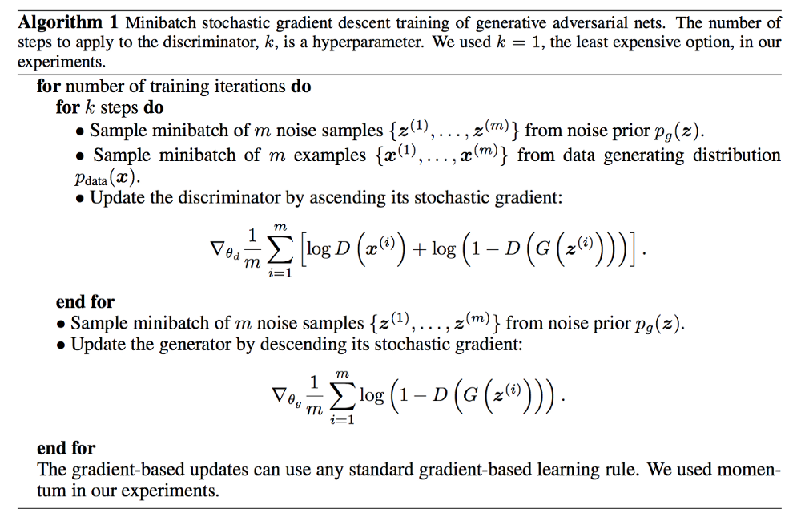
GAN - ALGORITHM

Slide 21
PROBLEMS IN GAN
MODE COLLAPSE – Generator (G) - struck – COMPLETE/PARTIAL.
VANISHING GRADIENT – Discriminator (D) - strong/weak.
HARD TO FIND NASH EQUILIBRIUM – one player does not change regardless of the other.

Slide 22
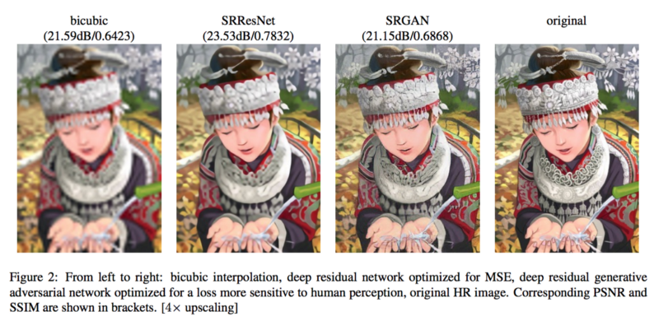
SOME COOL APPLICATIONS OF GAN
https://medium.com/@jonathan_hui/gan-some-cool-applications-of-gans-4c9ecca35900

Slide 23
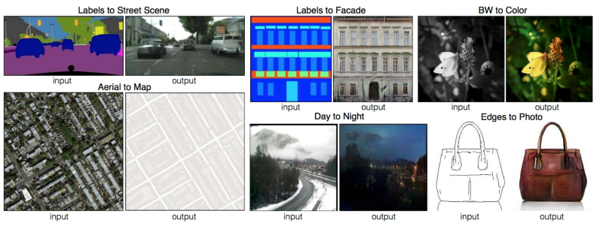
SOME COOL APPLICATIONS OF GAN
https://medium.com/@jonathan_hui/gan-some-cool-applications-of-gans-4c9ecca35900

Slide 24
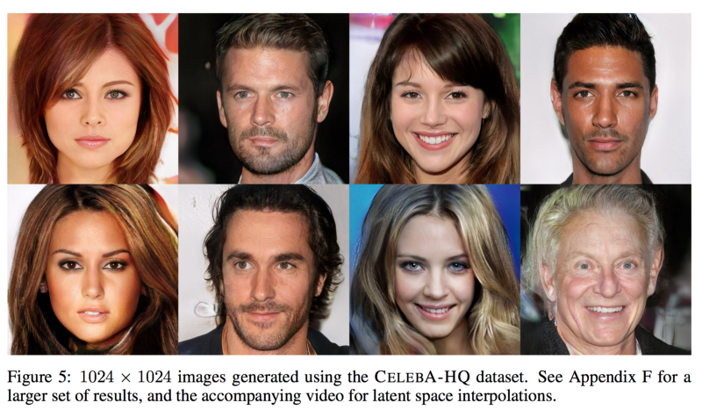
SOME COOL APPLICATIONS OF GAN
https://medium.com/@jonathan_hui/gan-some-cool-applications-of-gans-4c9ecca35900

Slide 25
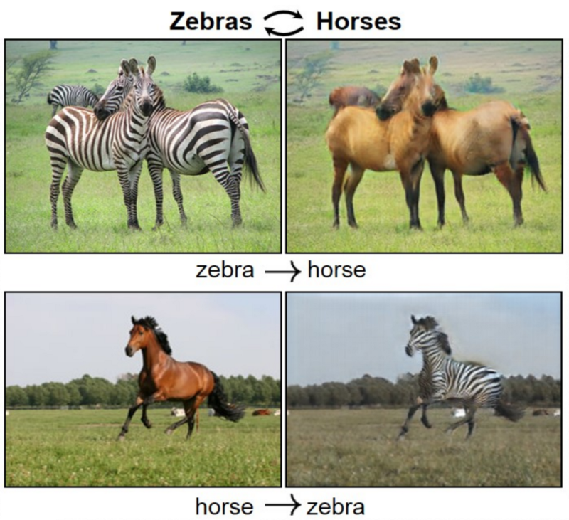
SOME COOL APPLICATIONS OF GAN
https://medium.com/@jonathan_hui/gan-some-cool-applications-of-gans-4c9ecca35900

Slide 26
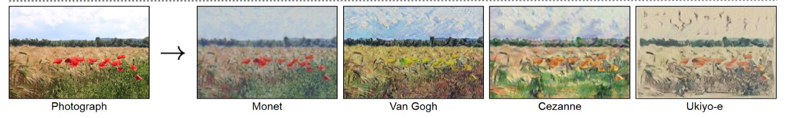
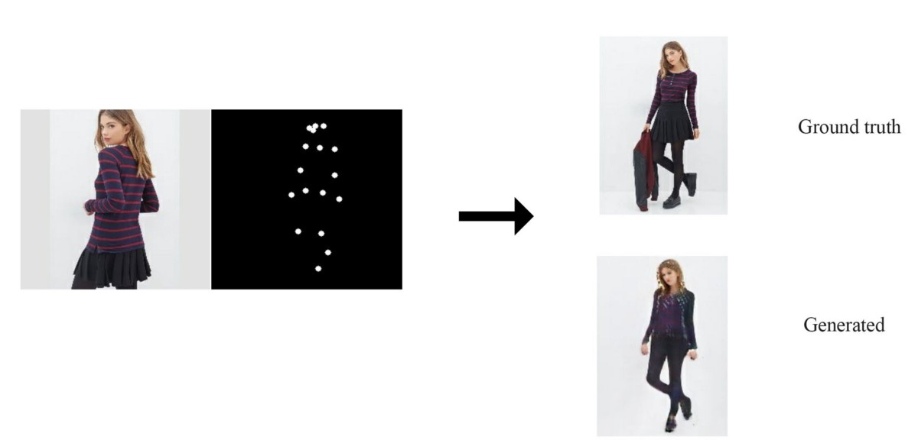
SOME COOL APPLICATIONS OF GAN
https://medium.com/@jonathan_hui/gan-some-cool-applications-of-gans-4c9ecca35900

Slide 27
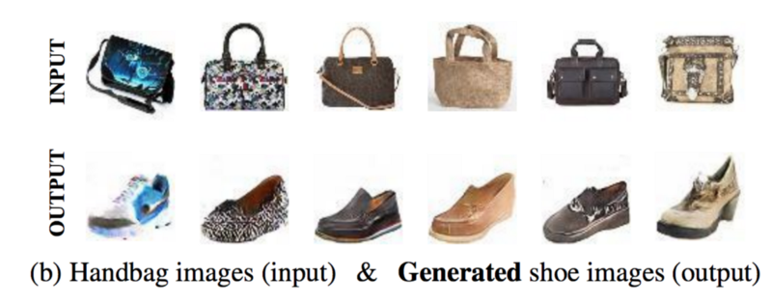
SOME COOL APPLICATIONS OF GAN
https://medium.com/@jonathan_hui/gan-some-cool-applications-of-gans-4c9ecca35900

Slide 28
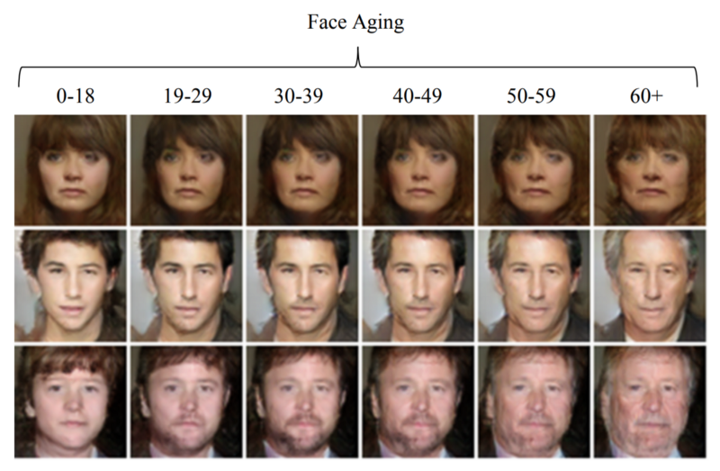
SOME COOL APPLICATIONS OF GAN
https://medium.com/@jonathan_hui/gan-some-cool-applications-of-gans-4c9ecca35900

Slide 29
REFERENCES
Ian.J.Goodfellow et al., “Generative Adversarial Nets”, Advances in Neural Information Processing Systems, 27, pp: 2672-2680, 2014.
Ian.J.Goodfellow, “NIPS 2016 Tutorial: Generative Adversarial Networks”.
Oreilly’s tutorial : https://www.oreilly.com/learning/generative-adversarial-networks-for-beginners.
Generative Adversarial Networks with Math : https://medium.com/deep-math-machine-learning-ai/ch-14-general-adversarial-networks-gans-with-math-1318faf46b43.
Andrew Ng CS229 Lecture Notes on Generative Learning Algorithms.
GANs from Scratch 1: A deep introduction. With code in PyTorch and TensorFlow : https://medium.com/ai-society/gans-from-scratch-1-a-deep-introduction-with-code-in-pytorch-and-tensorflow-cb03cdcdba0f.
https://learning.acm.org/techtalks/adversarialml
https://www.youtube.com/watch?v=Z6rxFNMGdn0&list=PLrAXtmErZgOdP_8GztsuKi9nrraNbKKp4
https://poloclub.github.io/ganlab/
https://www.youtube.com/watch?v=CIfsB_EYsVI

